Slide 2

PRIMERRA
SPC FLOORING
HERRINGBONE
All rights reserved

Slide 3
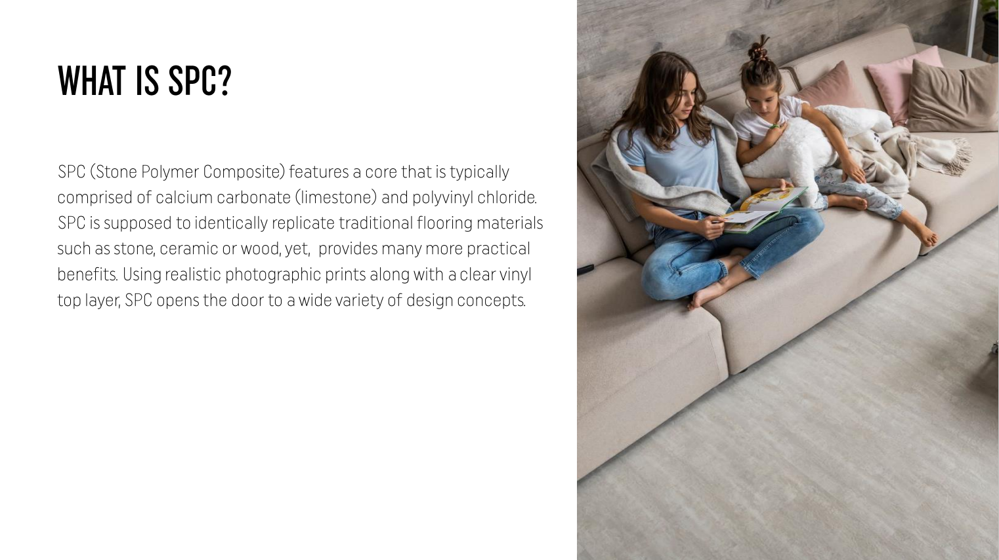

Slide 4
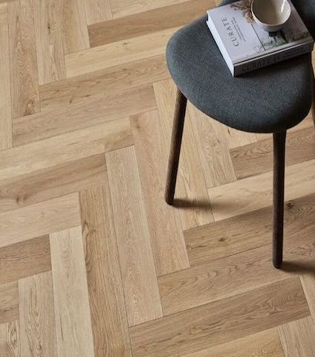



WHY HERRINGBONE?
Herringbone flooring is not just about style but also about enhancing the structural and aesthetic qualities of the space it is used in.
Benefits and Uses of Herringbone Flooring:
Elegant and Timeless: Herringbone patterns offer a sophisticated and timeless look, adding a sense of elegance to any space.
Visual Interest: The zigzag pattern creates visual interest and movement, making floors stand out.
Room Enhancement: This pattern can make small rooms appear larger and add depth to larger spaces.
Sturdy Construction: The interlocking design of the herringbone pattern can add stability and strength to the floor.
Where Herringbone Flooring is Commonly Used:
Living Rooms: Adds elegance and a focal point to the main gathering space.
Entryways and Hallways: Makes a stylish first impression
Kitchens and Dining Areas: Offers a chic and clean look that can be both modern and classic.
Bedrooms: Adds warmth and a cozy feel.
Commercial Spaces: Frequently used in boutique stores, hotels, and restaurants for a high-end look.

Slide 5
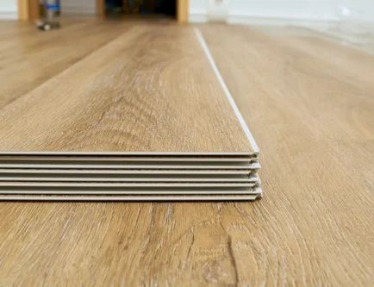


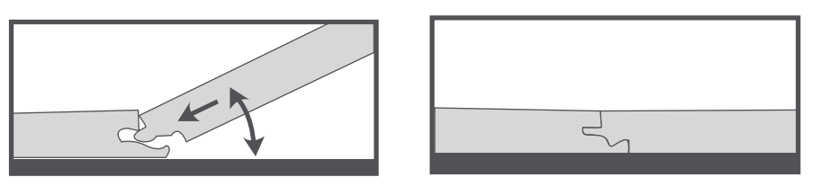
Main features
Quick and Easy Installation.
Levelling Unevenness
Unilin lock technology
Water - resistant
Stain Resistant
15 Years Warranty - Residential

Slide 6
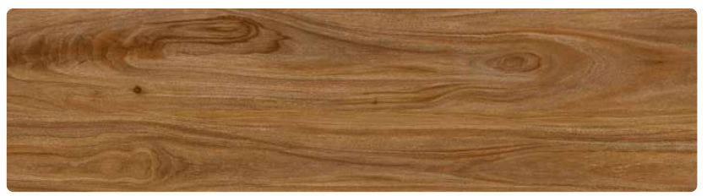
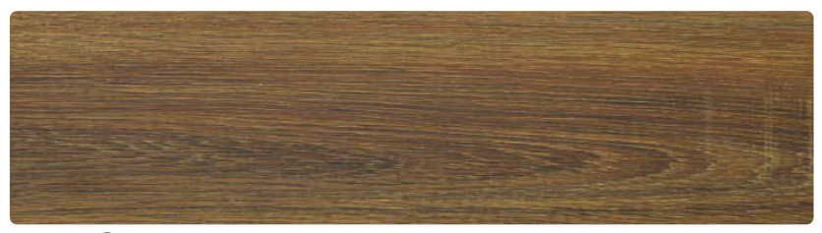
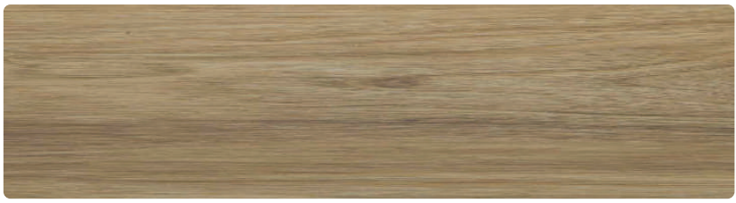
COLLECTIONS
GOLDEN OAK
WALNUT OAK
IMPERIAL OAK

Slide 7
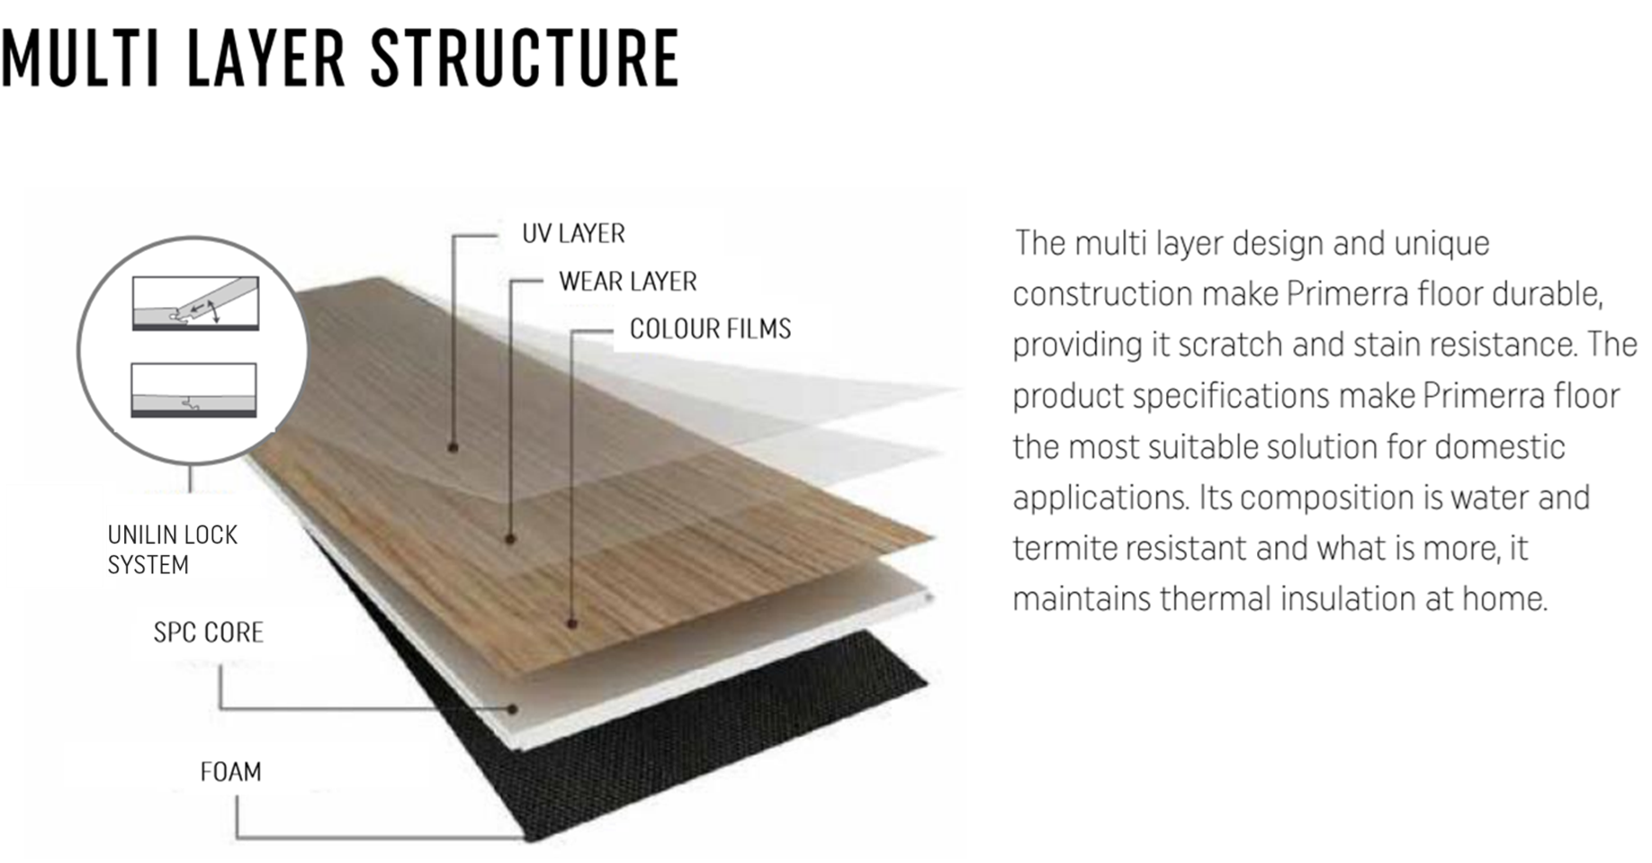



Slide 8
MOST IMPORTANT FLOOR PARAMETERS
Total thickness | 4 mm
Thickness of the wear layer | 0,3 mm
Lock | UNILIN LOCK TECHNOLOGY
Packaging | 2.63 m² (650x150) 27 tiles (PACK A AND PACK B)
Film appearance | No scratches, No tears
Surface scratch | ≤2000g No scratches
Gloss | 4-8 (Gu)
Profile acuracy | - Smooth, flat cuts - No excess plastic
Residual indentation | ASTM F1914 Max: s 3%
Locking strength | Tensile strength 30mm (2 110N) Flexural strength 15mm (23 N)
Dimension Stability | ISO 23999 Dry 80C for 6 hours Max s 0.17%
Abrasion (wear layer 0.3mm ) | ASTM D4060-Abrasion resistance tester Mac 4500Rev
Warranty residential use | 15 years
All rights reserved

Slide 9
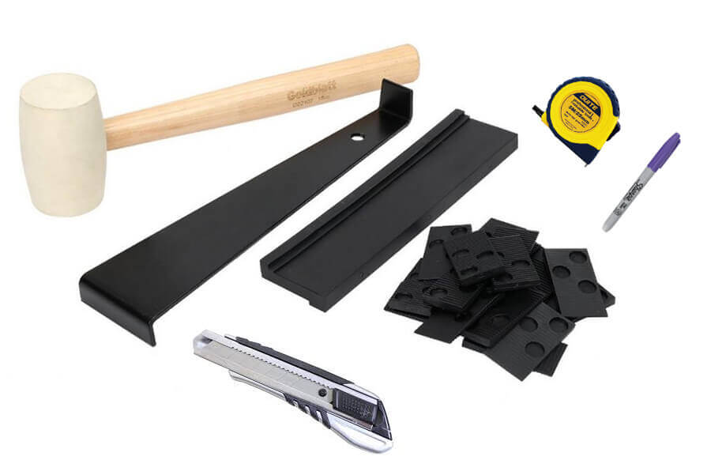
Tools needed for the installation
Straight edge
Pencil, Chalk Line
Measuring tape
Power Crosscut Saw
Jigsaw for cutting irregular shapes
Blue or Green Painter’s Tape
Assorted spacers
The rubber hammer and form sheet
All rights reserved

Slide 10
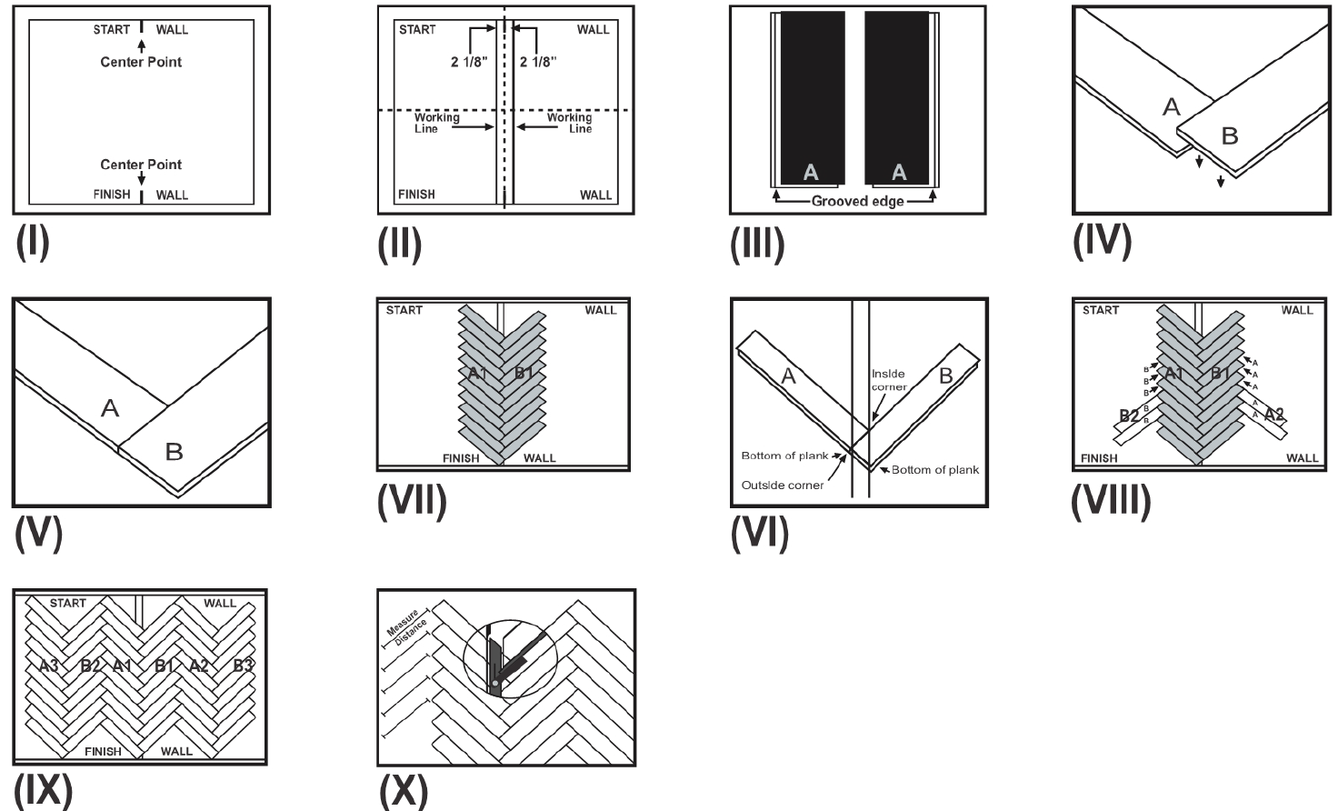
INSTALLATION

Slide 11
SPC FLOORING CARE & MAINTAIN
Heavy furniture, pet paws, sand, or any sharp objects will leave scratches and abrasions on the SPC flooring surface. Extra care is needed when it comes to contact with sharp and abrasive objects.
Clean with a damp mop for everyday care. Wash the floor occasionally with a gentle (non-abrasive) floor cleaner – always follow cleaning product instructions and adhere to caution before use. Do not use detergents or abrasive cleaners.

Slide 12
STORAGE
The product should be stored in covered rooms, out of the reach of heating devices and direct sunlight.
In conditions that protect the profiles against contamination, deformation and mechanical damage.
The packages should be stored on shelves or pallets with a length not shorter than the length of the package.
It is not allowed to leave the ends of the package unsupported and stack more than 10 packages on top of each other.

Slide 13
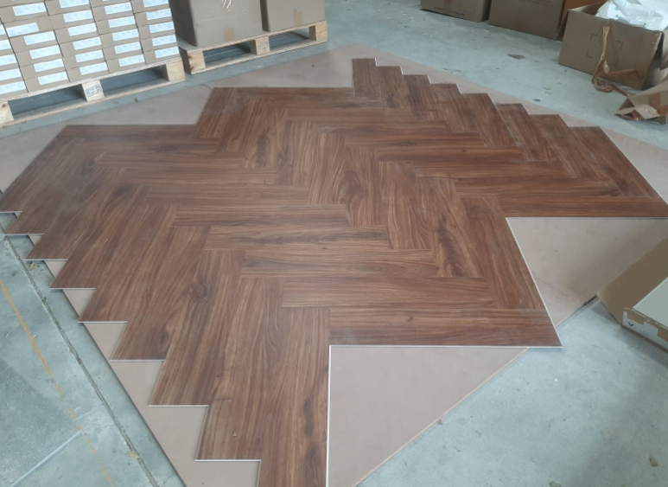
PROJECTS

Slide 14

INSTALLATION VIDEO

Slide 15
THANK YOU

